Slide 1

JAVA BASED TIC TAC TOE CONSTRUCTION

Slide 2

WHAT IS TIC TAC TOE?
TIC TAC TOE IS A CLASSIC TWO-PLAYER GAME THAT IS EASY TO LEARN BUT OFFERS GREAT OPPORTUNITIES TO PRACTICE PROGRAMMING LOGIC.
IT INVOLVES A 3X3 GRID WHERE PLAYERS TAKE TURNS MARKING A CELL WITH 'X' OR 'O'.
THE OBJECTIVE IS TO GET THREE OF YOUR MARKS IN A ROW, EITHER HORIZONTALLY, VERTICALLY, OR DIAGONALLY.

Slide 3

Learning Objectives:
Understanding Java Fundamentals:
Gain hands-on experience with basic Java syntax and structures.
Game Development Basics:
Learn the essentials of game logic and flow control.
Enhancing Problem-Solving Skills:
Develop skills in algorithmic thinking and debugging.
Practicing Object-Oriented Programming (OOP):
Use classes and objects to structure the game code.
PURPOSE OF THE PROJECT

Slide 4


WHY TIC TAC TOE?
Simple Rules:
The straightforward rules make it an excellent choice for beginners.
Immediate Feedback:
Players see the results of their moves instantly, facilitating a better understanding of the code’s functionality.
Expandable:
The project can be expanded with additional features like a graphical user interface (GUI) or an AI opponent.

Slide 5

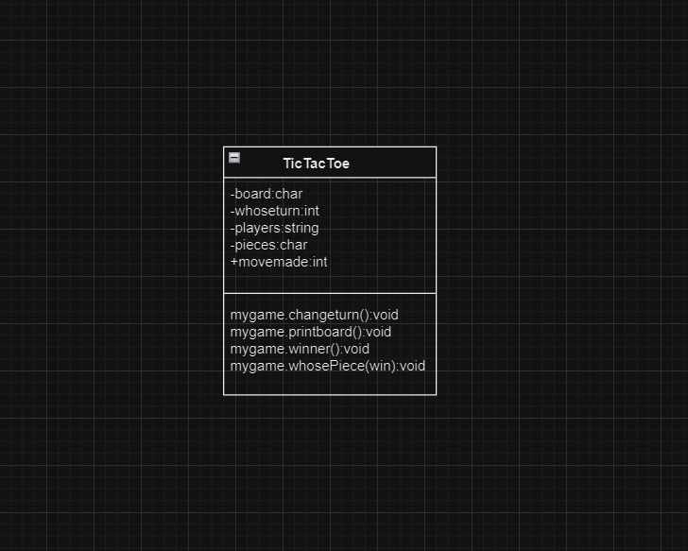
CLASS DIAGRAM

Slide 6
CODE
IMPORT JAVA.IO.*;
IMPORT JAVA.UTIL.*;
PUBLIC CLASS TICTACTOE {
PRIVATE CHAR[][] BOARD;
PRIVATE INT WHOSETURN;
PRIVATE STRING[] PLAYERS;
INT MOVESMADE;
FINAL STATIC PRIVATE CHAR[] PIECES = {'X','O'};
// INITIALIZES A TIC TAC TOE OBJECT.
PUBLIC TICTACTOE(STRING PLAYER1, STRING PLAYER2) {
BOARD = NEW CHAR[3][3];
FOR (INT I=0;I < 3; I++)
FOR (INT J=0; J < 3; J++)
BOARD[I][J] = '_';
WHOSETURN = 0;
MOVESMADE = 0;
PLAYERS = NEW STRING[2];
PLAYERS[0] = PLAYER1;
PLAYERS[1] = PLAYER2;
}
// TRIES TO MAKE A MOVE AT ROW, COLUMN. IF IT'S VALID THE MOVE IS MADE
// AND TRUE IS RETURNED. ELSE NOTHING IS DONE AND FALSE IS RETURNED.
PUBLIC BOOLEAN MOVE(INT ROW, INT COLUMN) {
IF ( (BOARD[ROW][COLUMN] == '_') && INBOUNDS(ROW,COLUMN) ) {
BOARD[ROW][COLUMN] = PIECES[WHOSETURN];
MOVESMADE++;
RETURN TRUE;
}
ELSE
RETURN FALSE;
}
// RETURNS TRUE IF INDEXES PASSED TO THE METHOD ARE INBOUNDS.
PUBLIC BOOLEAN INBOUNDS(INT ROW, INT COLUMN) {
IF ((ROW < 0) || (COLUMN < 0))
RETURN FALSE;
IF ((ROW > 2) || (COLUMN > 2))
RETURN FALSE;
RETURN TRUE;
}
// CHANGES WHOSE TURN IT IS.
PUBLIC VOID CHANGETURN() {
WHOSETURN = (WHOSETURN + 1)%2;
}
// RETURNS THE CURRENT PLAYER'S NAME.
PUBLIC STRING GETCURRENTPLAYER() {
RETURN PLAYERS[WHOSETURN];
}
// PRINTS OUT THE PLAYING BOARD.
PUBLIC VOID PRINTBOARD() {
SYSTEM.OUT.PRINTLN("\T0 1 2");
FOR (INT I=0; I<3; I++) {
SYSTEM.OUT.PRINT(I+"\T");
FOR (INT J=0; J<3; J++)
SYSTEM.OUT.PRINT(BOARD[I][J]+" ");
SYSTEM.OUT.PRINTLN();
}
}
// RETURNS A CHARACTER SIGNIFYING THE WINNER.
PUBLIC CHAR WINNER() {
// CHECK FOR THREE X'S OR O'S IN A ROW.
FOR (INT I=0; I<3; I++)
IF (SAMEARRAY(BOARD[I]) && BOARD[I][0] != '_')
RETURN BOARD[I][0];
// CHECK FOR THREE X'S OR O'S IN A COLUMN.
FOR (INT I=0; I<3; I++)
IF ((BOARD[0][I] == BOARD[1][I]) && (BOARD[1][I] == BOARD[2][I]) && BOARD[0][I] != '_')
RETURN BOARD[0][I];
// CHECKS FORWARD DIAGONAL. HERE, WE KNOW IF THERE ARE THREE BLANKS, NO ONE HAS ONE.
IF ((BOARD[0][0] == BOARD[1][1]) && (BOARD[1][1] == BOARD[2][2]))
RETURN BOARD[0][0];
IF ((BOARD[2][0] == BOARD[1][1]) && (BOARD[1][1] == BOARD[0][2]))
RETURN BOARD[2][0];
IF (MOVESMADE == 9)
RETURN 'T';
RETURN '_';
}
// CHECKS TO SEE IF ALL THE CHARACTERS IN A SINGLE CHARACTER ARRAY ARE
// THE SAME.
PRIVATE STATIC BOOLEAN SAMEARRAY(CHAR[] WORD) {
CHAR CHECK = WORD[0];
FOR (INT I=1; I<WORD.LENGTH; I++)
IF (CHECK != WORD[I])
RETURN FALSE;
RETURN TRUE;
}
// RETURNS THE PLAYER WHO'S PLAYING PIECE IS THE CHARACTER X.
PUBLIC STRING WHOSEPIECE(CHAR X) {
FOR (INT I=0; I<2; I++)
IF (X == PIECES[I])
RETURN PLAYERS[I];
RETURN "DUMMY";
}
PUBLIC STATIC VOID MAIN(STRING[] ARGS) THROWS IOEXCEPTION {
SCANNER STDIN = NEW SCANNER(SYSTEM.IN);
// READ IN PLAYERS' NAMES.
SYSTEM.OUT.PRINTLN("PLAYER #1, ENTER YOUR NAME.");
STRING NAME1 = STDIN.NEXT();
SYSTEM.OUT.PRINTLN("PLAYER #2, ENTER YOUR NAME.");
STRING NAME2 = STDIN.NEXT();
// CREATE THE TICTACTOE OBJECT.
TICTACTOE MYGAME = NEW TICTACTOE(NAME1, NAME2);
// PLAY AS LONG AS THERE IS NO WINNER OR TIE.
WHILE (MYGAME.WINNER() == '_') {
INT R,C;
BOOLEAN DONE = FALSE;
// READ IN A MOVE & CHECK IF IT'S VALID.
DO {
MYGAME.PRINTBOARD();
SYSTEM.OUT.PRINT(MYGAME.GETCURRENTPLAYER());
SYSTEM.OUT.PRINT(", ENTER THE ROW(0-2) AND COLUMN(0-2) ");
SYSTEM.OUT.PRINTLN("OF YOUR MOVE.");
R = STDIN.NEXTINT();
C = STDIN.NEXTINT();
IF (!MYGAME.INBOUNDS(R,C))
SYSTEM.OUT.PRINTLN("SORRY, THOSE ARE INVALID ENTRIES.");
ELSE {
IF (!MYGAME.MOVE(R,C))
SYSTEM.OUT.PRINTLN("SORRY, THAT SQUARE IS TAKEN.");
ELSE
DONE = TRUE;
}
} WHILE (!DONE);
// CHANGE WHO'S TURN IT IS.
MYGAME.CHANGETURN();
}
// PRINT OUT A MESSAGE WITH THE WINNER.
MYGAME.PRINTBOARD();
CHAR WIN = MYGAME.WINNER();
IF (WIN == 'T')
SYSTEM.OUT.PRINTLN("BOTH OF YOU PLAYED TO A TIE.");
ELSE {
SYSTEM.OUT.PRINT("CONGRATULATIONS, " + MYGAME.WHOSEPIECE(WIN));
SYSTEM.OUT.PRINTLN(", YOU HAVE WON THE GAME.");
}
}
}

Slide 7
EXPECTED OUTCOMES
DEVELOPED SKILLS:
JAVA PROGRAMMING:
PROFICIENT IN FUNDAMENTAL CONCEPTS SUCH AS LOOPS, CONDITIONALS, AND ARRAYS.
GAME LOGIC IMPLEMENTATION:
ABLE TO CONVERT GAME RULES INTO EXECUTABLE CODE.
USER INTERACTION:
SKILLED IN RECEIVING AND VALIDATING USER INPUT.
CODE ORGANIZATION:
EXPERIENCED IN ORGANIZING CODE THROUGH CLASSES AND METHODS FOR IMPROVED READABILITY AND REUSABILITY.

Slide 8
SUMMARY:
THE TIC TAC TOE PROJECT SERVES AS AN EFFECTIVE INITIATION INTO JAVA PROGRAMMING BY PROVIDING A BLEND OF SIMPLICITY AND CHALLENGE, CATERING WELL TO BEGINNERS SEEKING TO COMPREHEND FUNDAMENTAL CONCEPTS WHILE CONSTRUCTING A PLAYABLE GAME. UPON COMPLETION OF THIS PROJECT, YOU WILL HAVE NOT ONLY ENHANCED YOUR PROFICIENCY IN JAVA BUT ALSO ACQUIRED A CONCRETE PROJECT TO DEMONSTRATE YOUR CAPABILITIES.

